Slide 1

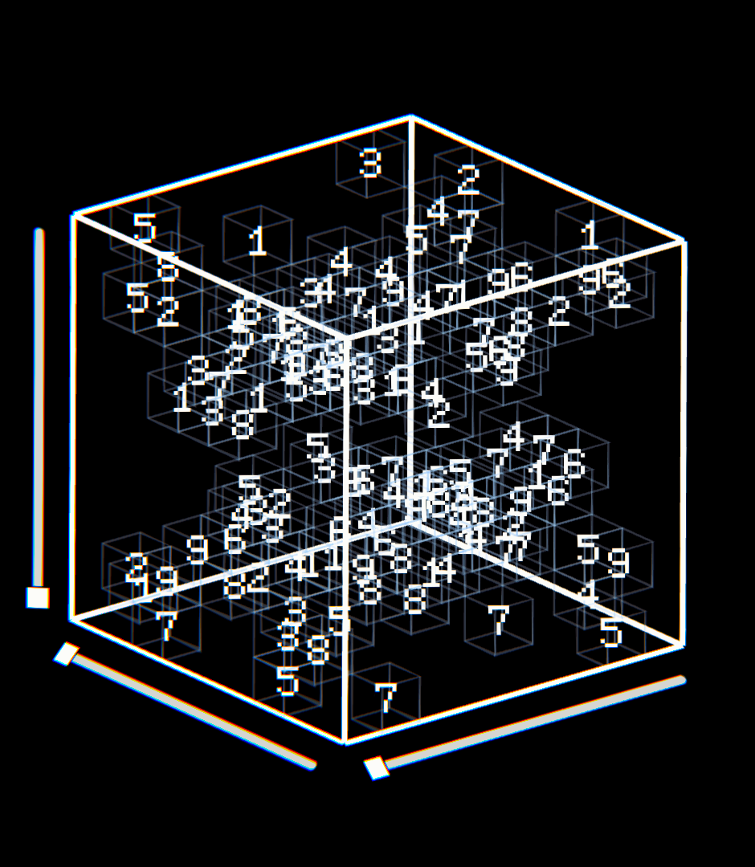
AI-Based Sudoku Puzzle Game
Group number: 02 Members:
Nuzhat Tasnim Silvia-2212314042
Md Al Amin-2212581042
Sunbib Ahmed-2212283642
Saadia Rahman Oyshi-2211047642

Slide 2
What we built A complete game, not a solver sitting on its own.
Playable 9×9 Sudoku
Users enter digits 1–9 into blank cells; pre-filled clues can't be changed
AI Generates Every Puzzle
Each difficulty level gets a freshly built, one-of-a-kind board.
AI Checks Every Move
Entries are matched against the solution automatically, in real time.
AI Helps When Asked
On request, it displays possible values and suggests one best move.
Score Reflects Play
Score shifts with difficulty, errors, and hints; finishing early adds a time bonus.
2
Group No 2 Nuzhat Tasnim Silvia 2212314042 Md Al Amin 2212581042 Sunbib Ahmed 2212283662 Saadia Rahman Oyshi 2211047642

Slide 3
How a game actually runs This is the working player loop
Choose a Level
Pick Easy, Medium, or Hard to generate a new puzzle.
1
Select Cell & Enter Number
Select a cell, enter 1-9; timer starts on first move
2
Get Instant Result
Green means correct, red flags a mistake.
3
Fix or Get Help
Erase, undo, or use AI hint auto-triggered after two mistakes.
4
Finish or Time Out
Finish shows your score; timeout starts a new puzzle.
5
Group No 2 Nuzhat Tasnim Silvia 2212314042 Md Al Amin 2212581042 Sunbib Ahmed 2212283662 Saadia Rahman Oyshi 2211047642

Slide 4
Working game features
Locked Clues
Fixed numbers stay noneditable to keep the puzzle valid..
01
Input & Highlighting
Numbers1-9 entered by keyboard or pad, spotlighting the active cell, its row/column/box, and matching digits.
02
Erase & Undo
Reverse or clear entries instantly, no restart needed.
03
Live Status Bar
Displays level, time left, mistakes, hints, and score in real time
04
New Game
Instantly generates a fresh puzzle at the current difficulty.
05
4
Group No 2 Nuzhat Tasnim Silvia 2212314042 Md Al Amin 2212581042 Sunbib Ahmed 2212283662 Saadia Rahman Oyshi 2211047642

Slide 5
Level
Easy
40 clues, 10:00. More clues, time to learn controls
Medium
32 clues, 7:00. Fewer clues, more empty cells
Hard
26 clues, 5:00. Fewest clues, highest score
Difficulty and timer
Harder games give fewer clues and less time.
Timer Behavior
Starts on the first real action selecting a cell, entering a number, erase, undo, or hint. At 00:00 the game ends, and a new shuffled puzzle of the same level starts automatically.
Group No 2 Nuzhat Tasnim Silvia 2212314042 Md Al Amin 2212581042 Sunbib Ahmed 2212283662 Saadia Rahman Oyshi 2211047642

Slide 6
AI engine: CSP + Backtracking How the solver actually works in this project.
Sudoku as a CSP
Variables: Empty cells
Domains: Numbers 1 to 9
Constraints: No repeat in a row, column, or 3×3 box
The same constraint check is used to generate puzzles, check player moves, and build AI hints.
Search Method in the Game
MRV Cell Choice: Pick the cell with fewest legal options first.
Try a Legal Value: Place a valid candidate.
Continue or Backtrack: Undo and retry if a later cell fails
Stop: Board full → unique solution. No options left → unsolvable (used while generating)
Group No 2 Nuzhat Tasnim Silvia 2212314042 Md Al Amin 2212581042 Sunbib Ahmed 2212283662 Saadia Rahman Oyshi 2211047642

Slide 7
Puzzle generation Every New Game follows this pipeline.
Fill Diagonal Boxes
The three non-overlapping 3×3 boxes are filled with shuffled 1–9 values as a valid start.
Solve the Rest
The CSP solver completes the remaining cells into a full valid grid.
Shuffle Safely
Rows and columns swapped, digits relabeled validity preserved.
Remove Clues Carefully
Numbers are deleted down to the level's clue count, keeping exactly one solution.
Group No 2 Nuzhat Tasnim Silvia 2212314042 Md Al Amin 2212581042 Sunbib Ahmed 2212283662 Saadia Rahman Oyshi 2211047642

Slide 8
Scoring and game outcomes The score is live during play and finalized on a win.
During Play
Base score: Easy 1000 · Medium 2000 · Hard 3000
50 points per mistake
75 points per AI hint
Time bonus not deducted while the clock runs
On Completion
Leftover seconds (Easy ×1, Medium ×2, Hard ×3)
250 completion bonus
Win dialog displays time used, mistakes, hints, and final score
Option to Play Again or change difficulty
Win: All cells match the solution; timer stops and final score is shown.
Timeout: Mistakes don't end the game; at 00:00, a new puzzle of the same level begins.
Group No 2 Nuzhat Tasnim Silvia 2212314042 Md Al Amin 2212581042 Sunbib Ahmed 2212283662 Saadia Rahman Oyshi 2211047642

Slide 9
AI hints Help for one cell. The board is not auto-solved.
Selected Cell
1
Row and column of the empty cell.
Possible Numbers
2
Legal domain after applying row, column, and box constraints.
AI recommendation
3
The true solution value for that cell, so the hint is never a wrong number.
Why that number is valid in this row, column, and 3×3 box.
Short explanation
4
Limits
3 hints per game. A hint is also given automatically after every 2 mistakes (at 2, 4, and 6).
Why this is useful
Teaches the constraint, not the answer player still places the number.
Group No 2 Nuzhat Tasnim Silvia 2212314042 Md Al Amin 2212581042 Sunbib Ahmed 2212283662 Saadia Rahman Oyshi 2211047642

Slide 10
Scoring and game outcomes The score is live during play and finalized on a win.
During Play
Base score: Easy 1000 · Medium 2000 · Hard 3000
50 points per mistake
75 points per AI hint
Time bonus not deducted while the clock runs
On Completion
Leftover seconds (Easy ×1, Medium ×2, Hard ×3)
250 completion bonus
Win dialog displays time used, mistakes, hints, and final score
Option to Play Again or change difficulty
Group No 2 Nuzhat Tasnim Silvia 2212314042 Md Al Amin 2212581042 Sunbib Ahmed 2212283662 Saadia Rahman Oyshi 2211047642

Slide 11
What This Means for the Project
Measured solver esults
Median nodes visited | Easy | Medium | Hard
Naive backtracking | 117 | 732 | 13,165
Backtracking + forward checking | 57 | 262 | 3,351
CSP+MRV (used in the game) | 42 | 50 | 83
CSP+MRV+ LCV(analysis only) | 42 | 50 | 78
CSP + MRV powers the game; LCV was tested but isn't used in production.
MRV drives performance picking the most constrained cell first keeps generation, checking, and hints fast.
Forward checking explores fewer nodes but runs slower than MRV here due to extra domain-pruning overhead.
Group No 2 Nuzhat Tasnim Silvia 2212314042 Md Al Amin 2212581042 Sunbib Ahmed 2212283662 Saadia Rahman Oyshi 2211047642

Slide 12
Thank you
Group No 2 Nuzhat Tasnim Silvia 2212314042 Md Al Amin 2212581042 Sunbib Ahmed 2212283662 Saadia Rahman Oyshi 2211047642

